Slide 1

Project
Comparison of Cloud Database Service OF AWS,ORACLE Using GCP

Slide 2


Objective
1
Set up the server, create and deploy the databases in Cloud platforms
2
OBJECTIVES
Evaluate and Analyze VM performance benchmark using third party tool.

Slide 3

Team Member
GRACE
AWS creation
GCP connection
ABSI
Oracle DB service
Solar winds installation
DB connectivity with analyzation

Slide 4
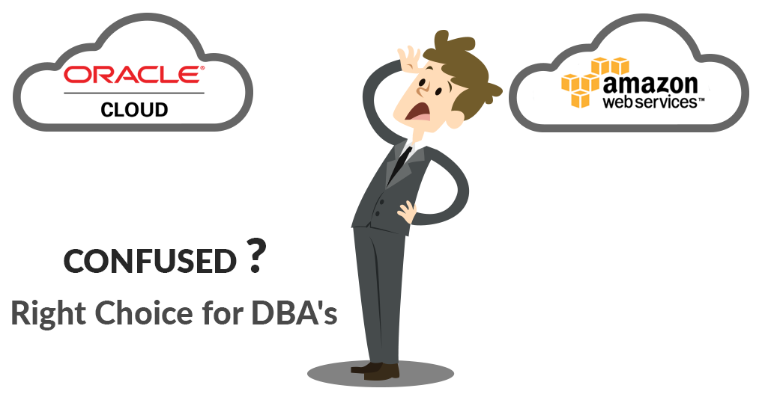
Type of Project
Development & Research with Evaluation

Slide 5
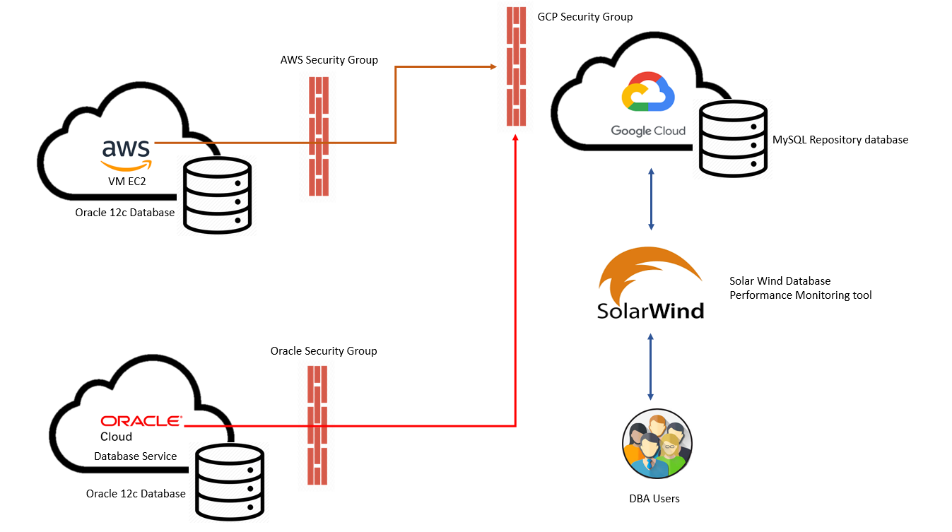
Architecture

Slide 6
Tools, Language & Platforms used
TOOLS
Oracle DB
SOLAR WINDS
LANGUAGE
SQL
SQL DEVELOPER
(DB CLOUD)
OS
Windows 2012RS
Linux(Rhel 7.6)
SOLAR WINDS
Database Performance Analyzer for AWS. It optimizes your EC2 or RDS -based application response times and solve
IDERA
SQL Diagnostic Manager (DM) for SQL Server. Monitor performance for physical, virtual, and cloud environments.
Wait statistics information is very helpful to diagnose database bottlenecks.
SQL DM does a good job of providing information at a high level, but also allows me to drill down to specific queries and events if needed.

Slide 7

EC2 Database Pre-Requisite
PROCESS 1
Installing rpm package manager from oracle repository.
Create a user and groups to run oracle DB on oracle user.
Set password for oracle user.
Disable selinux (disable Linux firewall) permission.
Download oracle software from oracle e-delivery.
Unzip the package and install the Oracle database 12c.
Create a listener
Create Database

Slide 8
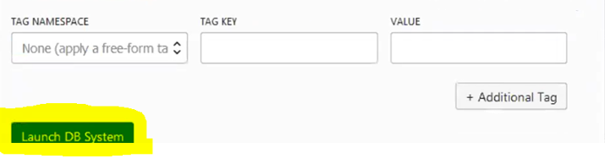
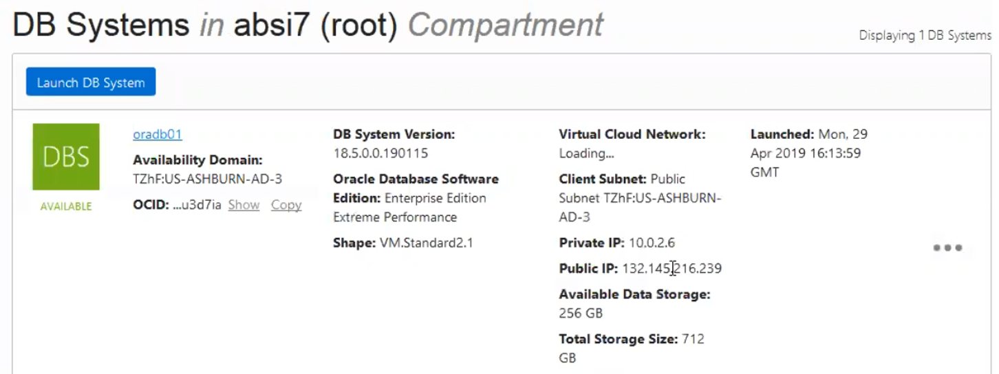
Create database service using Oracle Cloud
PROCESS 2
Launch DB System
Available DB Systems

Slide 9
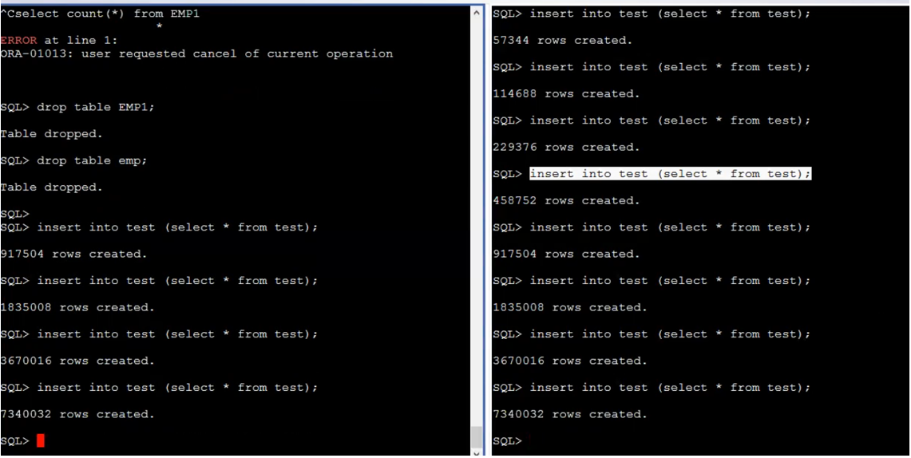
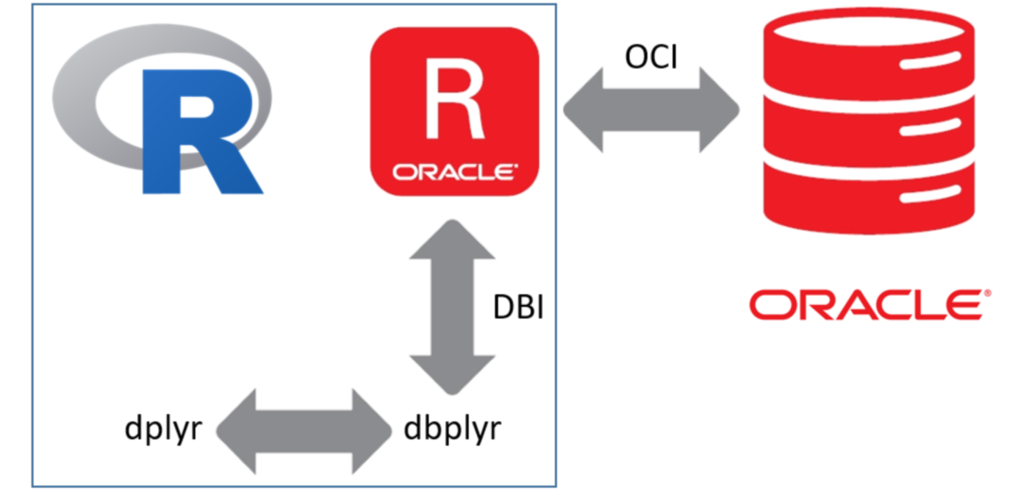
Mount Database
PROCESS 2 continues….
Mounted Database using Putty with 7.3M records
AWS
ORACLE

Slide 10
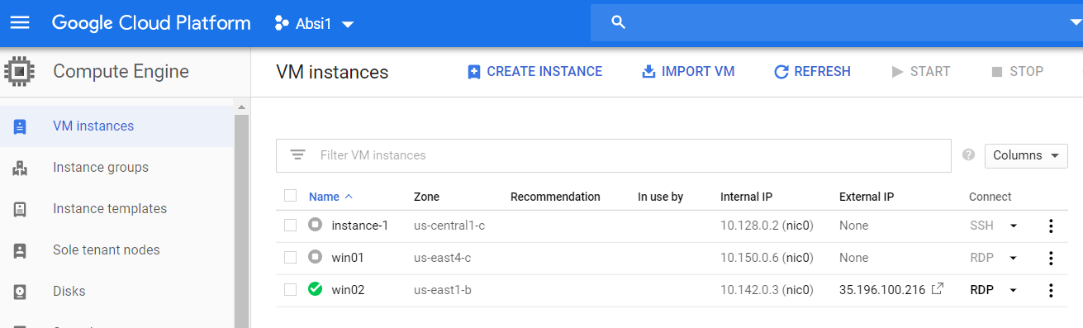
Create GCP VM Instance
PROCESS 3
Create GCP VM Instance.
Next connect to the remote desktop

Slide 11
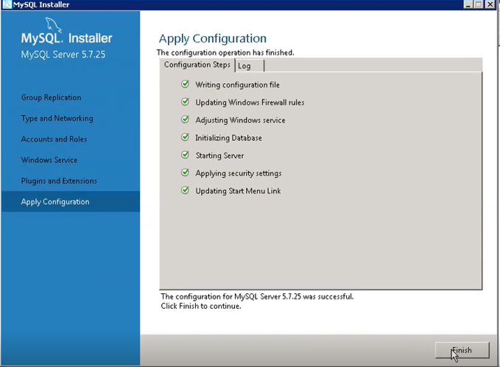
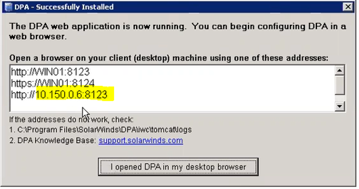
Create GCP VM Instance
PROCESS 3 continues…
Create a Repository Database for the
Performance using GCP remote desktop
Install SolarWinds Performance Analyzer

Slide 12
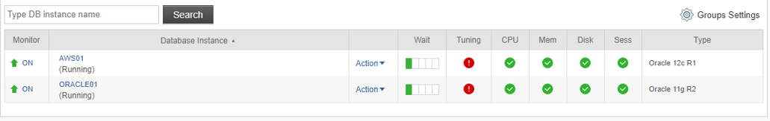
Create GCP VM Instance
PROCESS 3 continues….
Connect AWS EC2 database in SolarWind (DPA)
Connect Oracle database service in SolwarWind (DPA)

Slide 13

Benchmarking Performance Analysis of Database
ANALYZING PARAMETERS
READ
WRIT
READ
WRITE
COMMIT
TRANSACTION
COMMIT
TRANSACTION

Slide 14
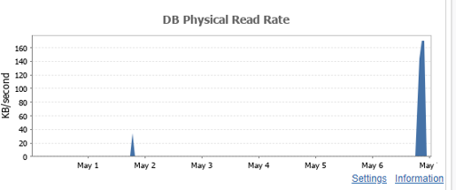
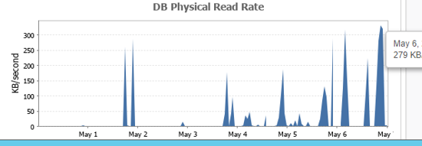
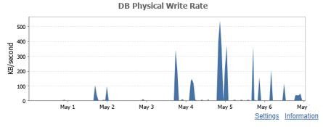
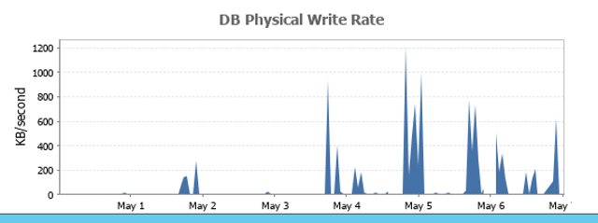
Benchmarking Performance Analysis of Database
READ
AWS
ORACLE
WRITE

Slide 15
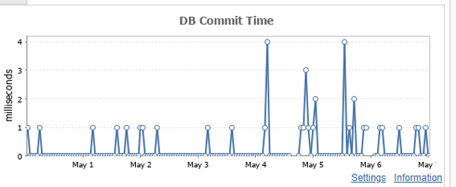
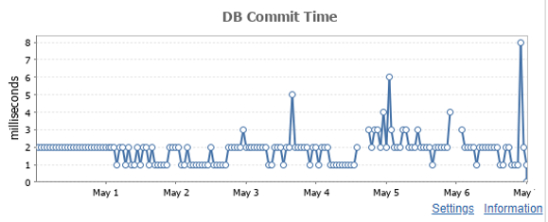
Benchmarking Performance Analysis of Database
COMMIT
AWS
ORACLE

Slide 16
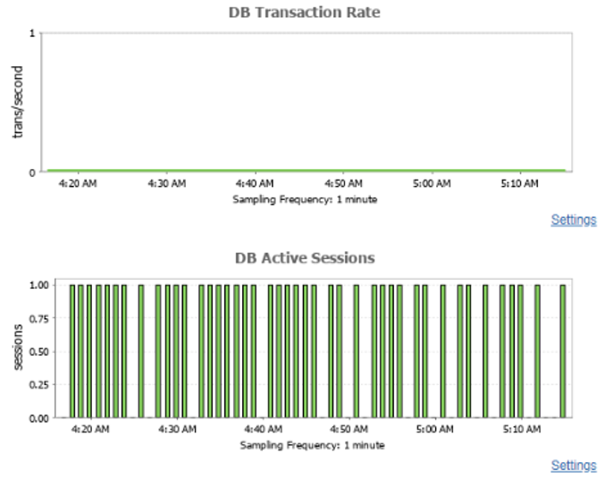
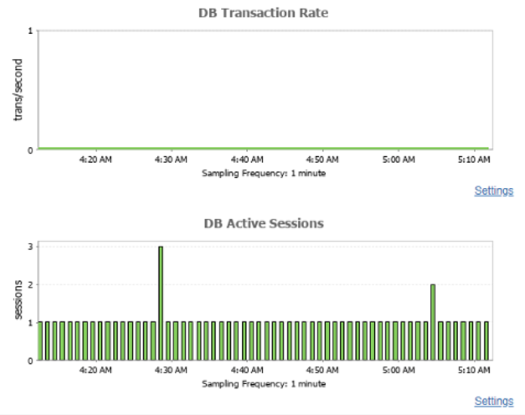
Benchmarking Performance Analysis of Database
TRANSACTION
AWS
ORACLE

Slide 17
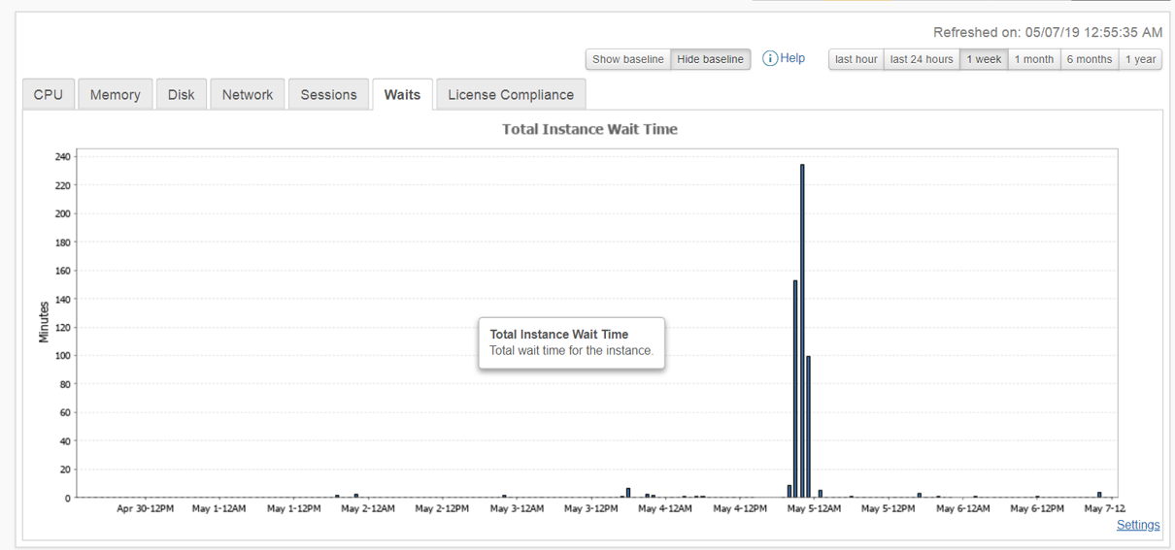
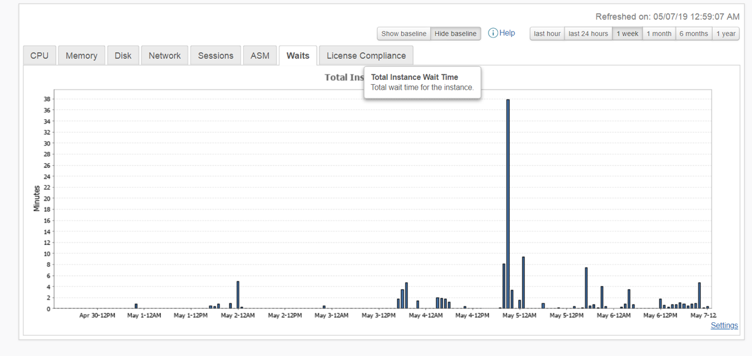
Benchmarking Performance Analysis of Database
AWS week wait performance
Oracle week wait poor performance

Slide 18


Conclusion
In the beginning AWS was slow but after a week the performance of oracle got reduced and the AWS was much better in running the query at best performance rate than oracle.
CPU utilization is better with AWS than Oracle DB service performance tuning was requested by the tool.
Oracle was better initially but now it takes long time to run the
database where the wait time is much longer.
This is the conclusion driven by the week performance monitoring.

Slide 19

Learning
Server setup
DB creation with pre requisite
Connecting the cloud server
Analyzing with benchmarking
Comparing the analysis
U can also learn through github: https://github.com/gracesyl

Slide 20


Challenges faced
AWS DB creation configuration prerequisite was difficult with adding the swap space to the server; after this oracke12c was installed.
Initially created Oracle cloud DB service using VMS however couldn’t connect the server after the first trial because of the free tier utilization.
GCP windows desktop was quite challenging with the firewall disabling in order to download and install the SolarWinds(DPA).
Connectivity of Databases into the GCP tool was quite challenging.
We had to do a lot of trial and error versions. Once the trial version was over, we had to install another VM and performance tool to the cloud.

Slide 21
Thank You

